Slide 1

TOP Hit Prediction
Applied Data Science

Slide 2
Scope
Identify Possible top hits per region based on song features
Music plays a significant role in our lives, and with the rise of digital music platforms like Spotify, it has become easier than ever to access and discover new music. In this data science project, our goal is to identify the top hits per region based on song features using three Spotify datasets provided by Kaggle. The datasets are "Top Hits Spotify from 2000-2019" by Paradisejoy, "Spotify 12M Songs" by Rodolfo Figueroa, and "Spotify Chart Data" by J Freyberg.
By analyzing the song features such as tempo, danceability, energy, and others, we aim to understand the characteristics that make a song popular in a particular region. This information can be useful for music streaming platforms, record labels, and artists to make informed decisions about their music releases and marketing strategies.
In this project, we will perform exploratory data analysis to gain insights into the data, select the relevant features, build a machine learning model to predict the popularity of songs, and evaluate its performance. Finally, we will present the results and draw insights into the popularity of songs in different regions.
By the end of this project, we hope to gain a deeper understanding of the relationship between song features and regional popularity and to provide valuable insights that can help shape the future of the music industry.
Notes:
Introduction to use case, goal, selection of data set

Slide 3
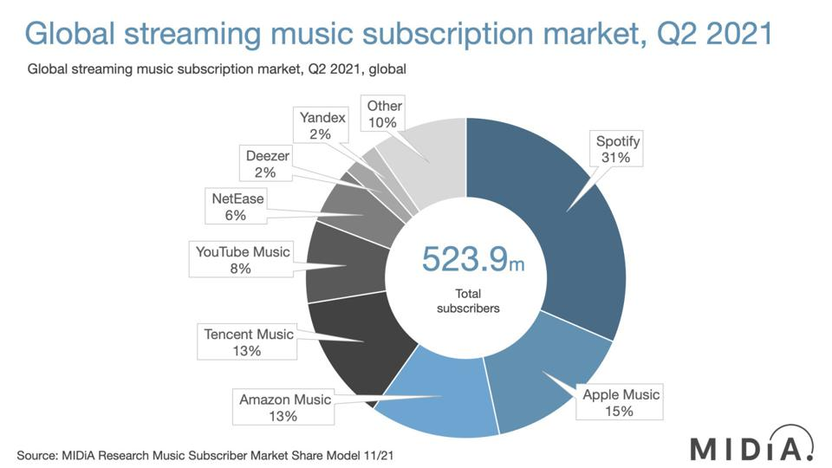
Notes:
Source: Forbes
https://www.forbes.com/sites/eamonnforde/2022/01/19/spotify-comfortably-remains-the-biggest-streaming-service-despite-its-market-share-being-eaten-into/?sh=6f71a5134743

Slide 4

Domain Exploration - Hit Song Science
Area first defined by Mike McCready in 2002 (CEO of Polyphonic)
Goal/Business Model:
Evaluate Hits before they are released
Identify & match musical preferences of certain groups
Original Procedure: Analyze mathematical structure of rhythm, changes in key & melodic pattern
Notes:
Brief literature review about domain and previous data science projects in this domain
Sources:
Ruth Dhanaraj; Beth Logan (2005) „AUTOMATIC PREDICTION OF HIT SONGS”
Internet → Web Archive 2005:
https://hitsongscience.com/
http://www.polyphonichmi.com/about_us.php

Slide 5
Domain Exploration – Previous Data Science Projects
Goals | Input | Features | Methods | Result
Predict Song Popularity (>90%) | SF Developer Application Programming Interface | Explicitness, Instrumentals, Danceability | KNN, Random Forest, Gradient Boosted Trees, Logistic Regr. | Max. 72% Accuracy
Predict Hit in Billboard Hot 100 | Million Song Data Set (MSD), SF API (Extra) | All API Features & Artist Score (Custom) & Release Tiem | EM, LR, GDA, SVM, DT and NN (RF) | 69 - 77% Accuracy (81 – 89% Accuracy)
Determine Variation of Attributes to Streams | Spotify API (Custom Python Code) | Genre (SF) & All API Features | Correlation Analysis, Linear Regression | Low Explanatory Power
Determine Variation of Attributes to Popularity | Spotify WEB API (Custom Code) ONE Artist | All API Features | Beta regression model, GLMM, Beta GLMM | Mixed Explanatory Power (some Pos, some neg, rest irrelev)
Determine Features of Successful Playlists | Spotify & Surveys |  | Plotting | Intimacy, Focus & Variety
Characterize Trendy Music Clusters | Spotify API | All API Features | KNN | Variety of Size & Attributes
Notes:
Sources:
L1: Dawson, Christopher E. Jr.; Mann, Steve; Roske, Edward; and Vasseur, Gauthier (2021) "Spotify: You have a Hit!," SMU Data Science Review: Vol. 5: No. 3, Article 9.
L2: Georgieva, Elena; Suta Marcella; Burton, Nicholas: “HITPREDICT: PREDICTING HIT SONGS USING SPOTIFY DATA” (2018)
L2,5: Middlebrook, Kai; Sheik, Kian: „SONG HIT PREDICTION: PREDICTING BILLBOARD HITS USING SPOTIFY DATA “ (2019)
L3: Nijkamp, Rutger “Prediction of product success: explaining song popularity by audio features from Spotify data” (2018)
L4: Spera, Carola; Sciandra, Marangela “A Model Based Approach to Spotify Data Analysis: A Beta GLMM” (2020)
L5: George John Jordan Thomas Aquinas Hayward „What makes a playlist succesful? “ (https://ghayward.github.io/assets/files/Data_Scientist_Presentation_George_JJTA_Hayward.pdf)
L6: http://www.na-businesspress.com/JMDC/JMDC14-3/8_Al-BeitawiFinal.pdf
TBD: Methoden + Datensätze + Selected Features
Abkürzungen:
Expectation Maximization (EM), Logistic Regression (LR), Gaussian Discriminant Analysis (GDA), Support Vector Machines (SVM), Decision Trees (DT), and Neural Networks (NN)
Random Forest (RF)
Generalized Linear Mixed Models (GLMM)
All API Features:
Danceability, Energy, Speechiness, Acousticness, Instrumentalness, Liveness, Valence, Loudness, and Tempo
Duration, Mode

Slide 6

Domain Exploration
Go for Use Case
Decision of Data Base
Limitations:
Bias due to Spotify API
Limited to Data Base Info e.g. No Genre
No Details of Calculation
Excludes Soft Factors

Slide 7
Domain Exploration – Previous Data Science Projects
Goals | Input | Result
Predict Song Popularity (>90%) | Spotify API | Max. 72% Accuracy
Predict Hit in Billboard Hot 100 | Spotify API & Million Song Data Set (MSD) | 69 - 77% Accuracy 81 – 89% Accuracy
Determine Variation of Attributes to Streams | Spotify API | Low Explanatory Power
Determine Variation of Attributes to Popularity | Spotify API | Mixed Explanatory Power
Determine Features of Successful Playlists | Spotify API & Surveys | Intimacy, Focus & Variety
Characterize Trendy Music Clusters | Spotify API | Variety of Size & Attributes
Multiple Approaches
Different Goals & Data Input
Different Results
Notes:
Sources:
L1: Dawson, Christopher E. Jr.; Mann, Steve; Roske, Edward; and Vasseur, Gauthier (2021) "Spotify: You have a Hit!," SMU Data Science Review: Vol. 5: No. 3, Article 9.
L2: Georgieva, Elena; Suta Marcella; Burton, Nicholas: “HITPREDICT: PREDICTING HIT SONGS USING SPOTIFY DATA” (2018)
L2,5: Middlebrook, Kai; Sheik, Kian: „SONG HIT PREDICTION: PREDICTING BILLBOARD HITS USING SPOTIFY DATA “ (2019)
L3: Nijkamp, Rutger “Prediction of product success: explaining song popularity by audio features from Spotify data” (2018)
L4: Spera, Carola; Sciandra, Marangela “A Model Based Approach to Spotify Data Analysis: A Beta GLMM” (2020)
L5: George John Jordan Thomas Aquinas Hayward „What makes a playlist succesful? “ (https://ghayward.github.io/assets/files/Data_Scientist_Presentation_George_JJTA_Hayward.pdf)
L6: http://www.na-businesspress.com/JMDC/JMDC14-3/8_Al-BeitawiFinal.pdf

Slide 8
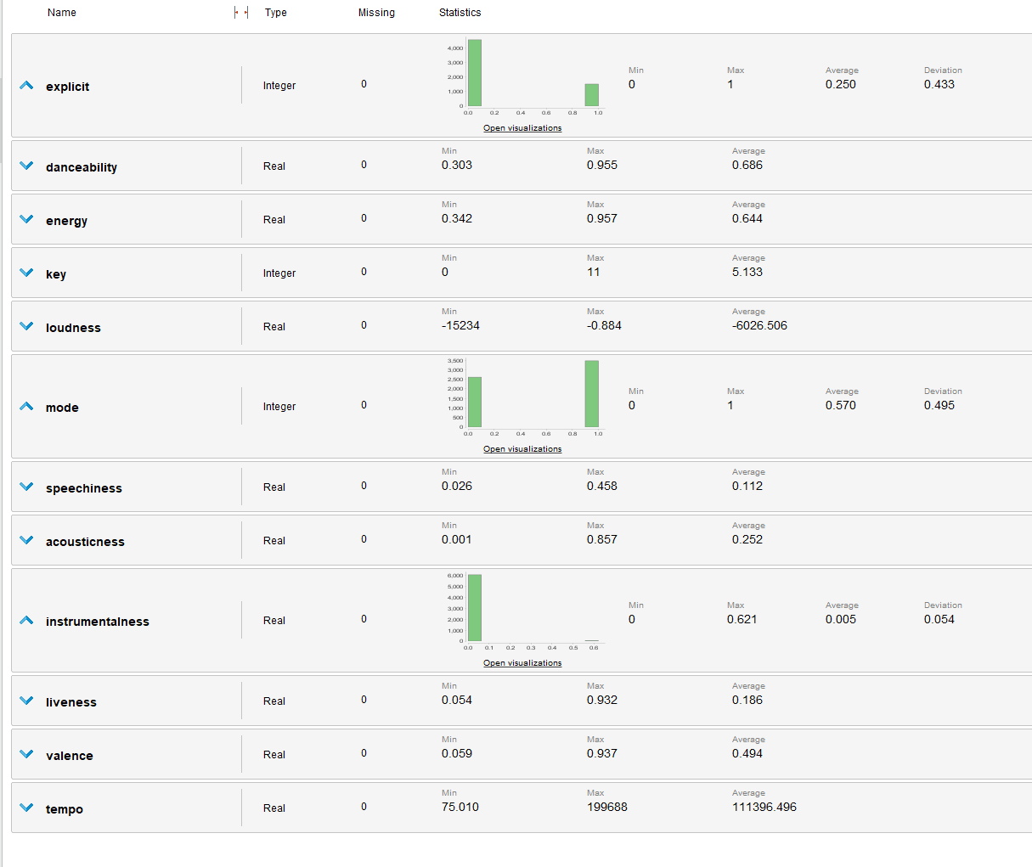
FP Growth – Imbalanced Attributes

Slide 9
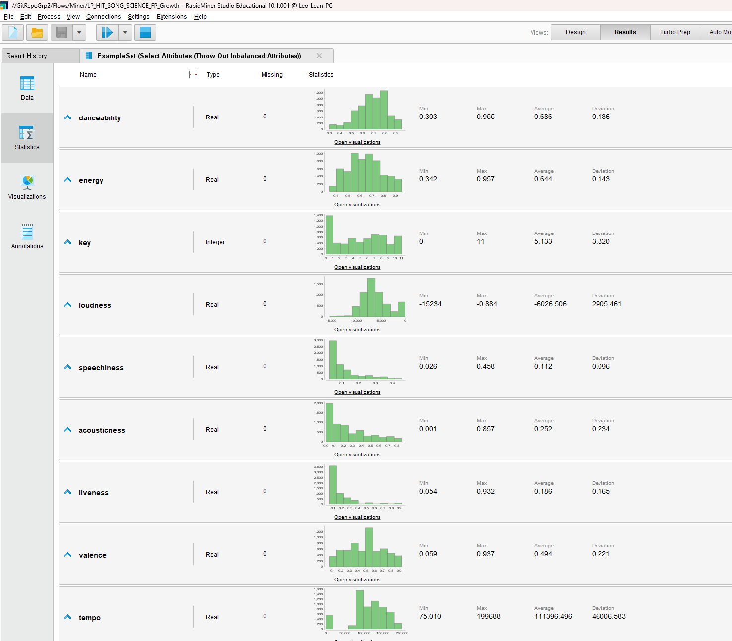
FP Growth – Remaining Attributes

Slide 10
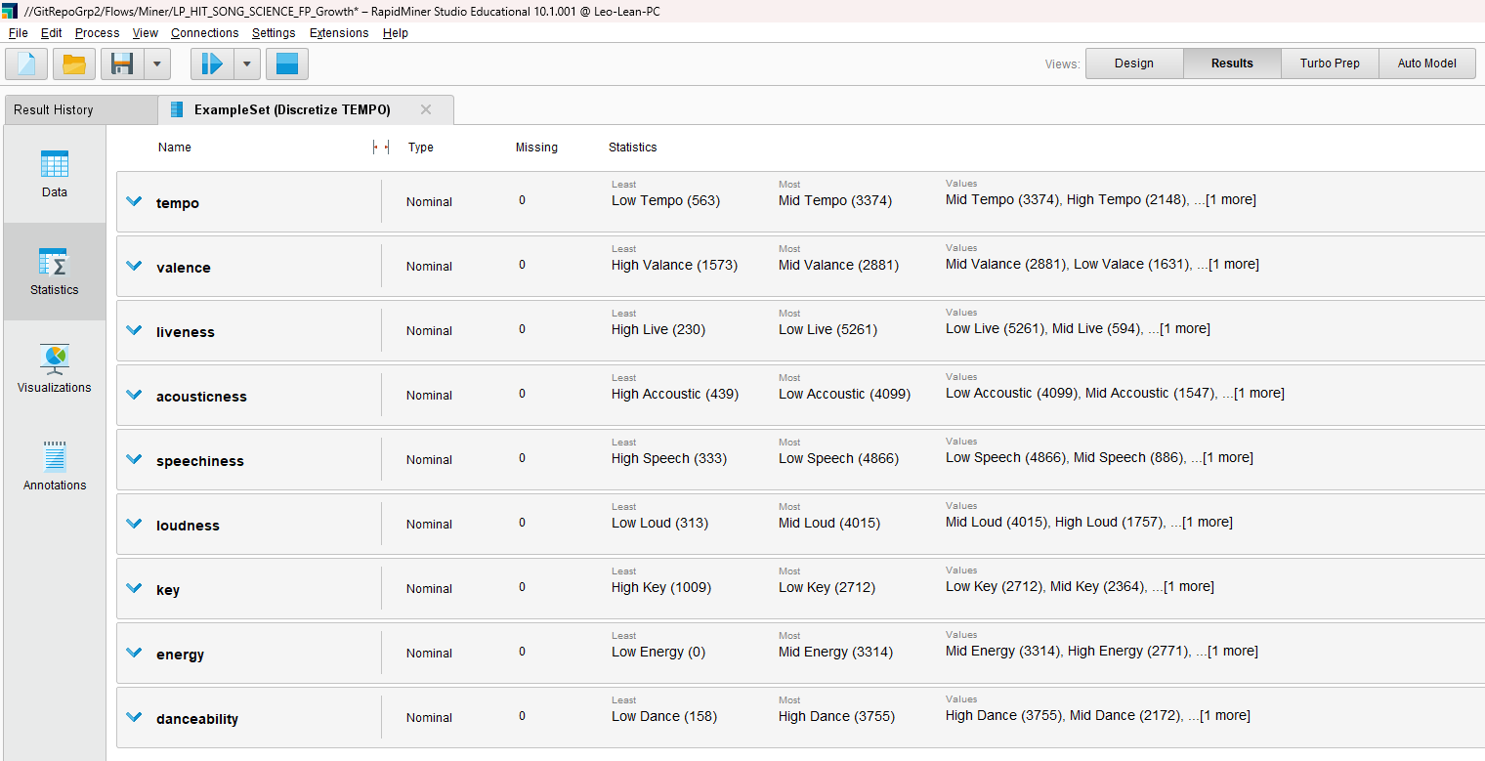
FP Growth – Binning Result

Slide 11
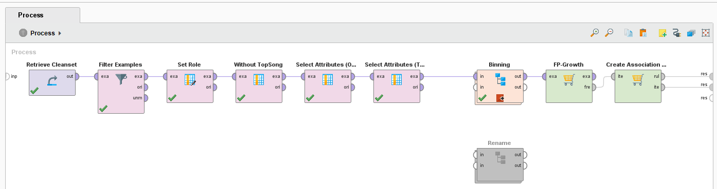
FP Growth – ProcesS

Slide 12
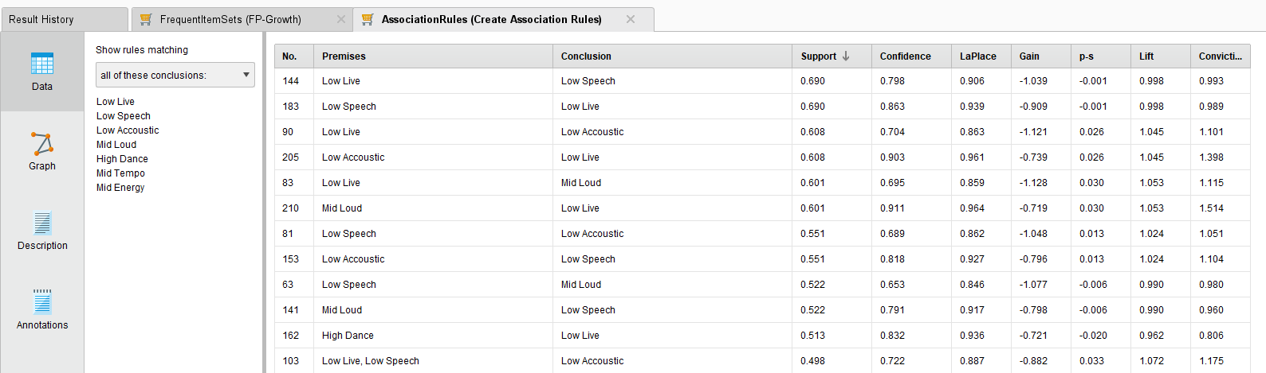
FP Growth – Result

Slide 13
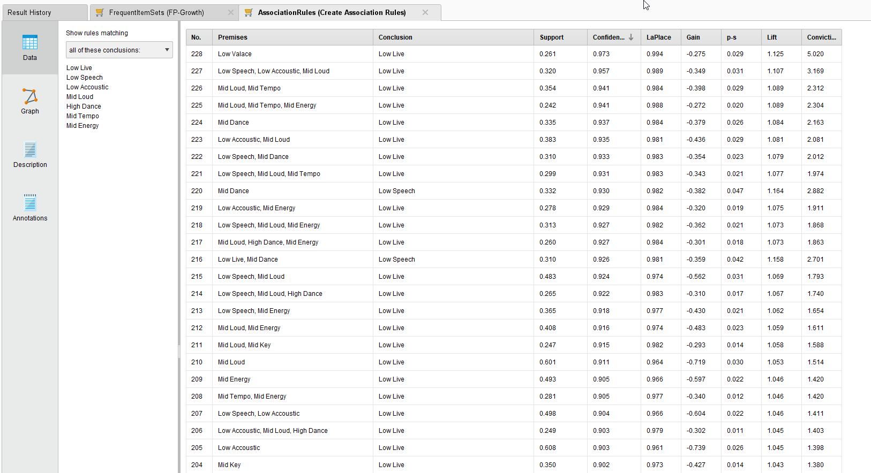
FP Growth – Result (TRUE) (First Round)

Slide 14
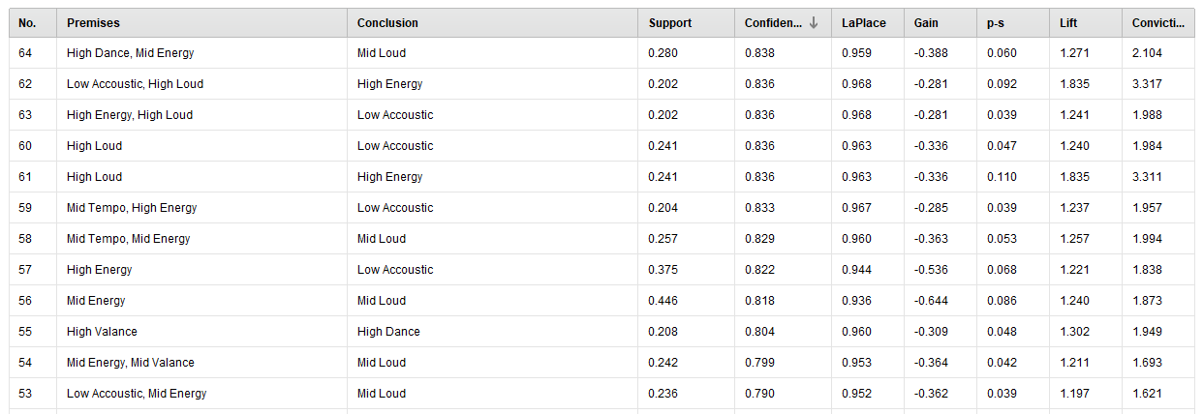
FP Growth – Result (TRUE) (Second Round)

Slide 15
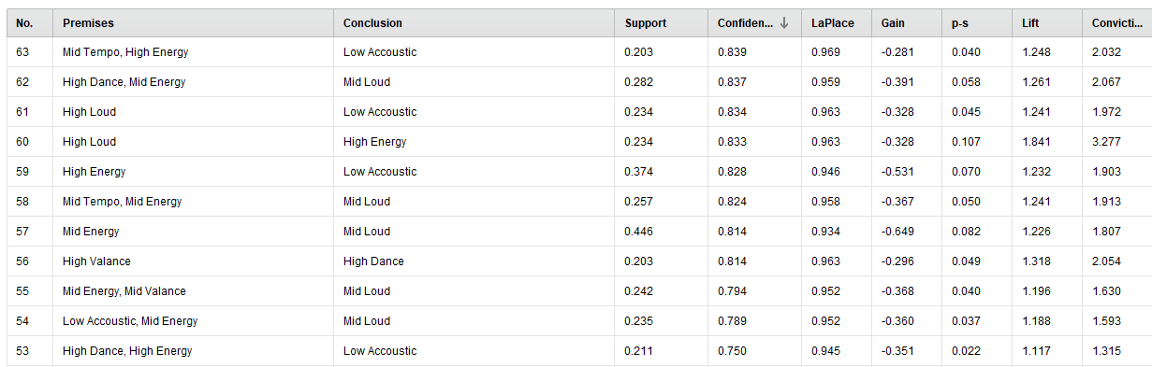
FP Growth – Result (False)

Slide 16
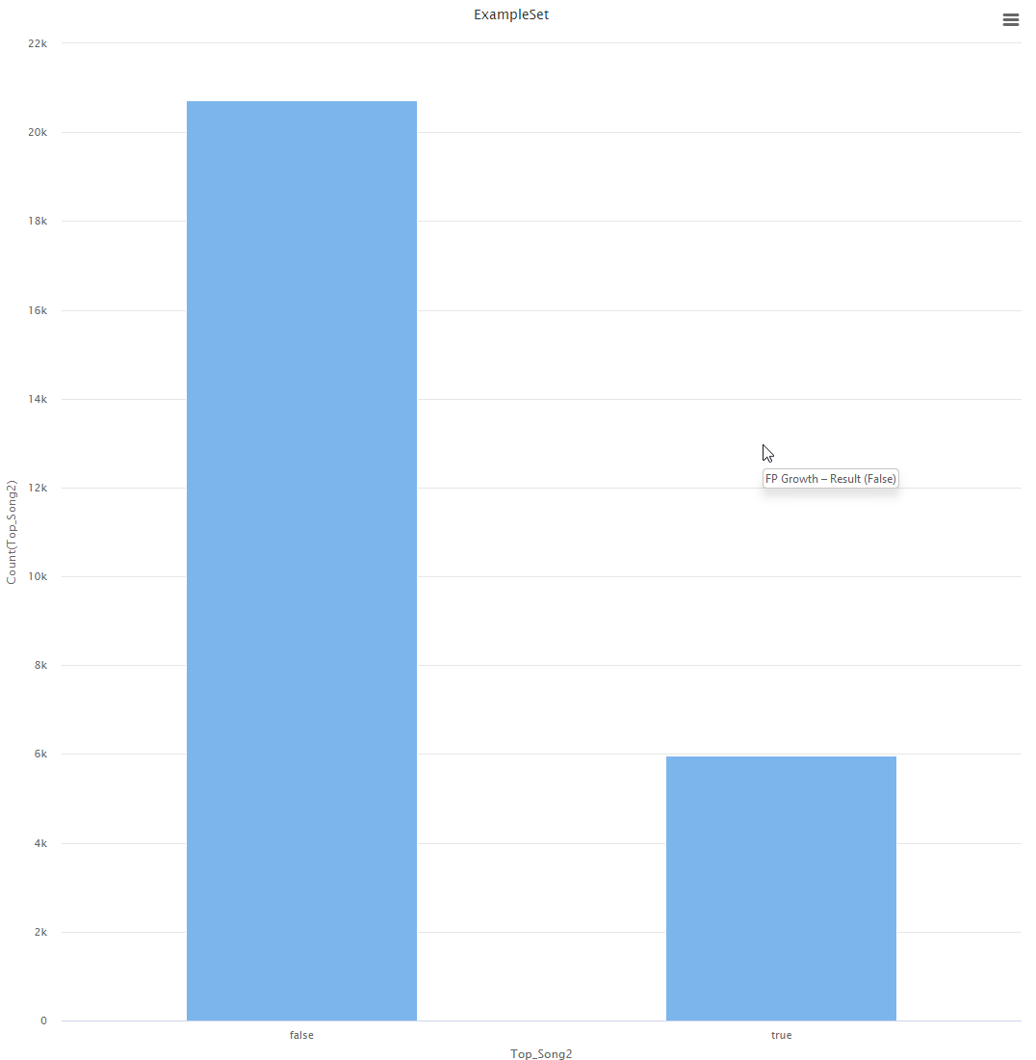
FIRST Iteration Unbalanced

Slide 17
First Iteration unbalanced

Slide 18
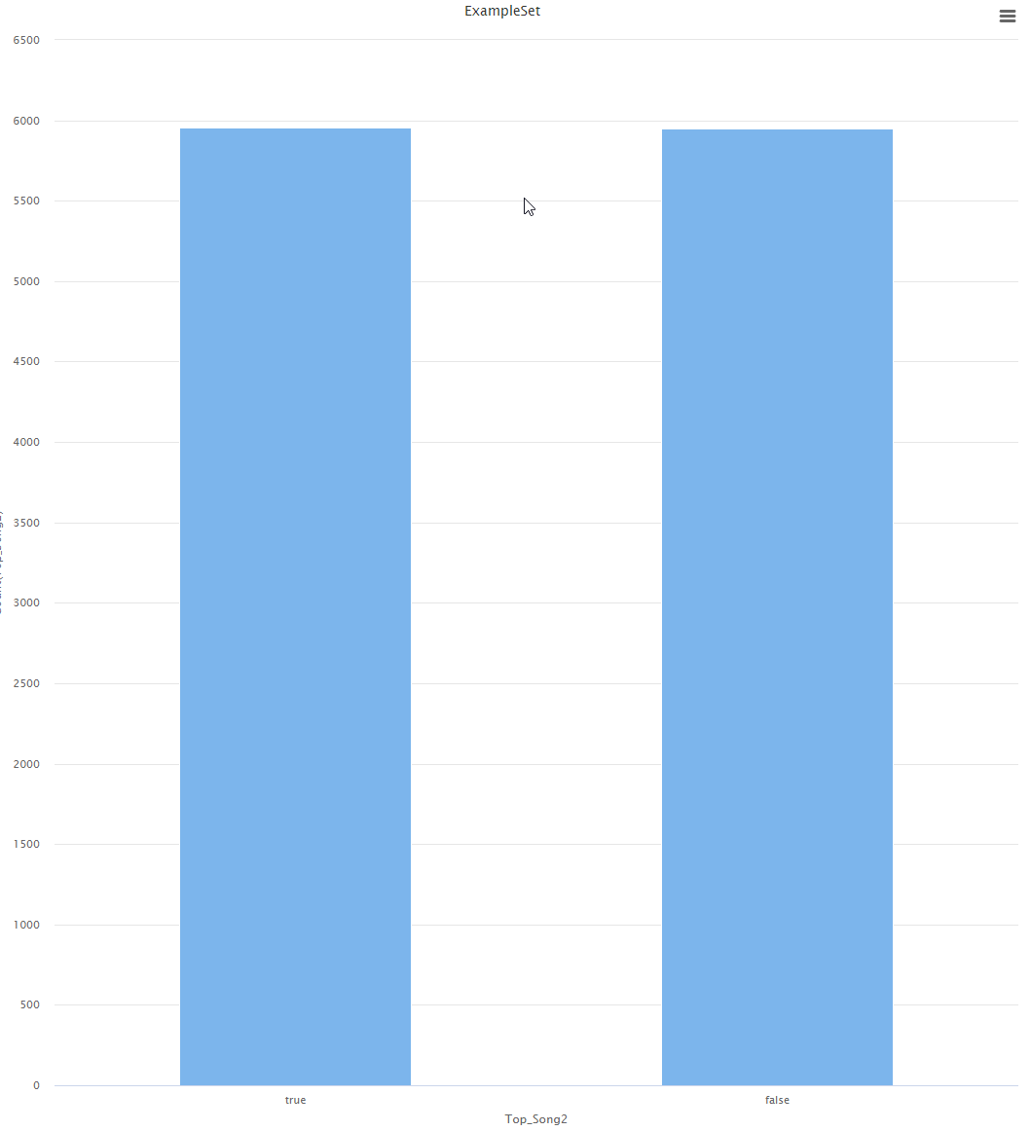
FIRST Iteration Balanced

Slide 19
First Iteration Balanced

Slide 20
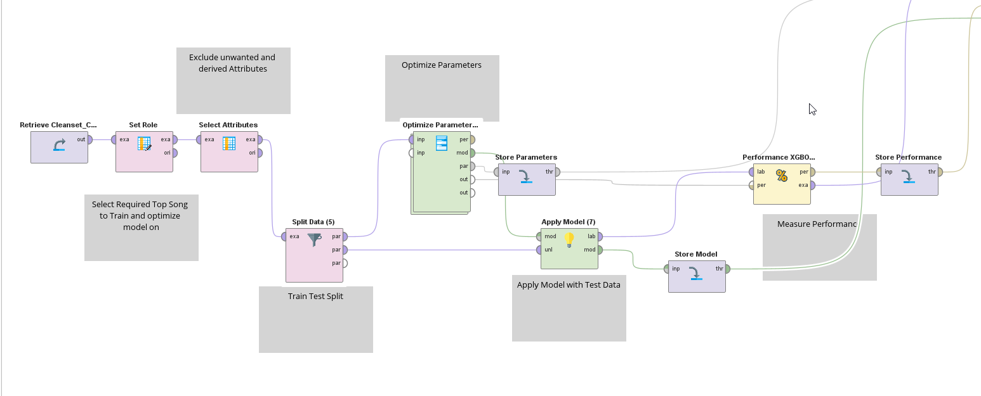
Second Iteration Model Template -- Parameter Tuning

Slide 21
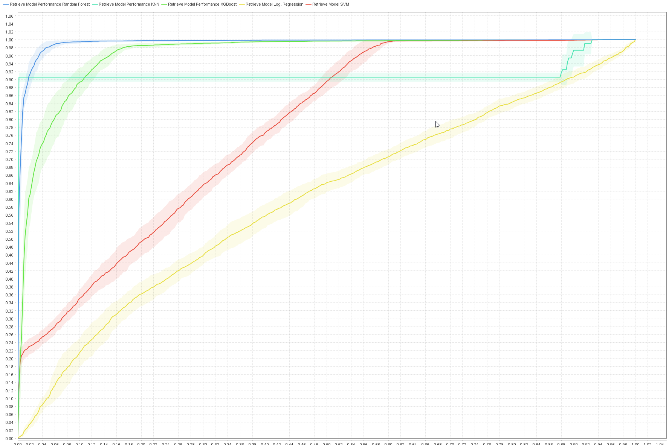
Second Iteration Results After Training

Slide 22
Second Iteration Random forest is the best performing model

Slide 23
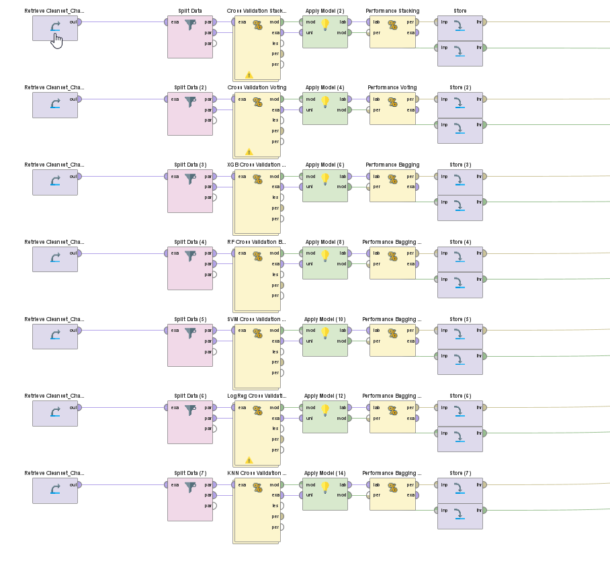
Second Iteration Model Template -- Ensembles

Slide 24
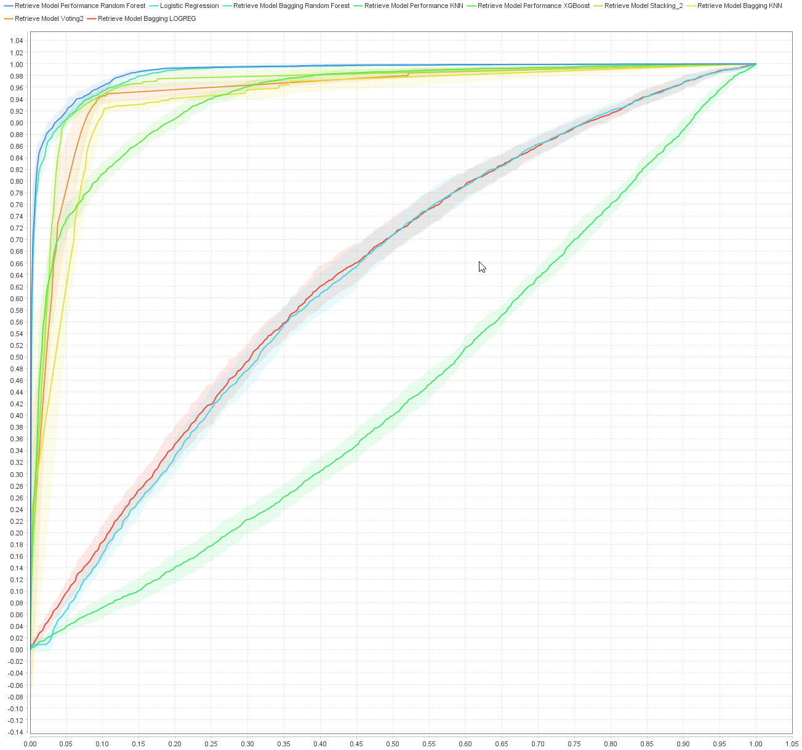
Second Iteration Model Template -- Ensembles

Slide 25
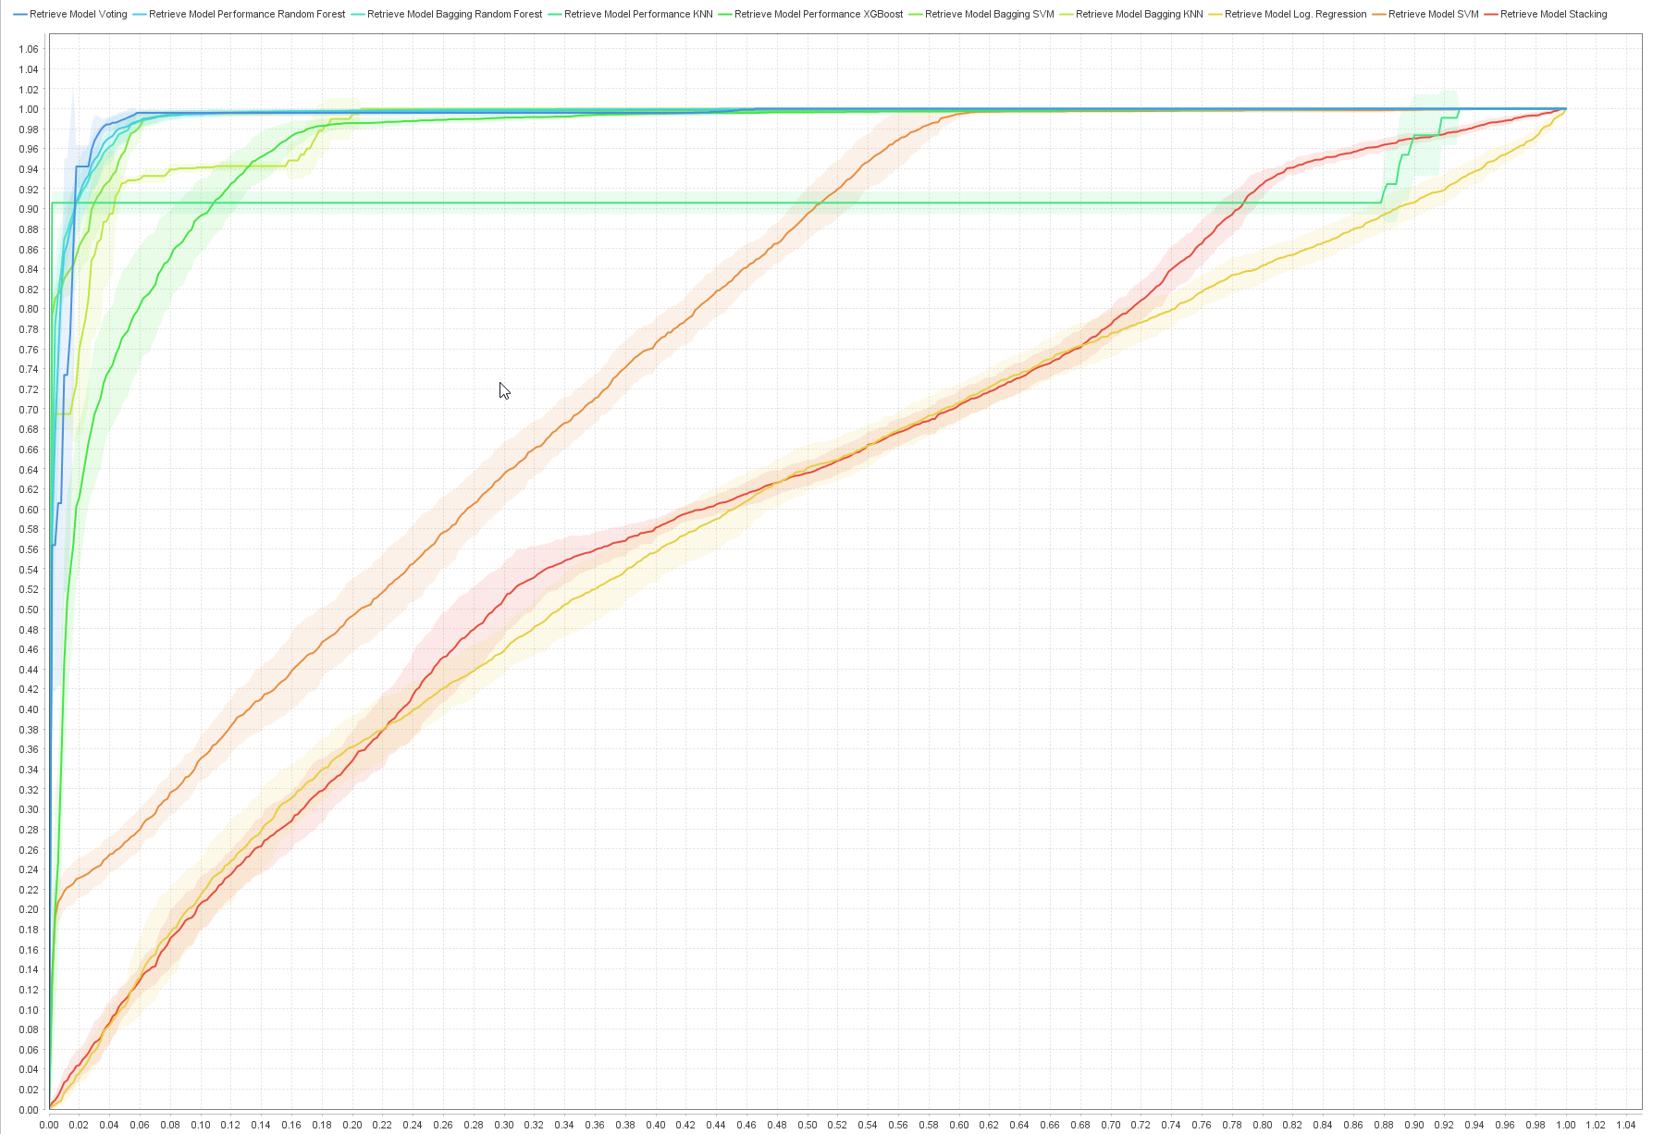
Second Iteration Modeling Result – ROC

